Slide 1
W4153 – Cloud Computing Lecture 8: REST, PaaS, FaaS, Logic Placement Composition, EDA, MDP
© Donald F. Ferguson, 2024

Slide 2

Contents
2 | W4153-F24-8-REST-PaaS-FaaS-Logic-Placement-Composition-EDA-MDP © Donald F. Ferguson, 2024

Slide 3
Contents
A note on grading.
REST continued:
Review principals of REST and HATEOAS
Idempotent
Linked resources ➔ Initial motivation for GraphQL
Platform-as-a-Service, Function-as-a-Service
Nested doll model
PaaS overview
FaaS overview
Application Development Concepts
”My” development framework and style
Overall microservice project structure
Where does application logic go? UI? Microservice? Database?
Composition continued
Architecture of my next logical sprint
Orchestration vs Choreography
Models: synchronous code, asynchronous code, event driven, queued, “workflow”
Sprint 2 discussion
I published some examples on GitHub/Ed.
Next Lecture.
I want to give you time to get the basic composition pulled together.

Slide 4
A Note on Grading
4 | W4153-F24-8-REST-PaaS-FaaS-Logic-Placement-Composition-EDA-MDP © Donald F. Ferguson, 2024

Slide 5
Grading Policy
The review and grading of your final project determines your grade.
What project or application scenario you choose does not matter.
We cover a set of topics in class.
Your “correctly” using and applying the concepts in your project/application determines your grade on the final project.
We will provide a “checklist” to guide you.
The documented sprint requirements incrementally define the final checklist.
Why do we require the “homework assignments” and “grade them.”
It allows us to assess how well the class and teams are progressing.
It allows us to provide incremental, continuous feedback.
There is no reason to request a regrade. Requesting an explanation or details does not make sense.

Slide 6
REST Continued
6 | W4153-F24-8-REST-PaaS-FaaS-Logic-Placement-Composition-EDA-MDP © Donald F. Ferguson, 2024

Slide 7
Reminder
Introduction
7 | W4153-F24-8-REST-PaaS-FaaS-Logic-Placement-Composition-EDA-MDP © Donald F. Ferguson, 2024

Slide 8
REST (https://restfulapi.net/)
What is REST
REST is acronym for REpresentational State Transfer. It is architectural style for distributed hypermedia systems and was first presented by Roy Fielding in 2000 in his famous dissertation.
Like any other architectural style, REST also does have it’s own 6 guiding constraints which must be satisfied if an interface needs to be referred as RESTful. These principles are listed below.
Guiding Principles of REST
Client–server – By separating the user interface concerns from the data storage concerns, we improve the portability of the user interface across multiple platforms and improve scalability by simplifying the server components.
Stateless – Each request from client to server must contain all of the information necessary to understand the request, and cannot take advantage of any stored context on the server. Session state is therefore kept entirely on the client.
Cacheable – Cache constraints require that the data within a response to a request be implicitly or explicitly labeled as cacheable or non-cacheable. If a response is cacheable, then a client cache is given the right to reuse that response data for later, equivalent requests.
Uniform interface – By applying the software engineering principle of generality to the component interface, the overall system architecture is simplified and the visibility of interactions is improved. In order to obtain a uniform interface, multiple architectural constraints are needed to guide the behavior of components. REST is defined by four interface constraints: identification of resources; manipulation of resources through representations; self-descriptive messages; and, hypermedia as the engine of application state.
Layered system – The layered system style allows an architecture to be composed of hierarchical layers by constraining component behavior such that each component cannot “see” beyond the immediate layer with which they are interacting.
Code on demand (optional) – REST allows client functionality to be extended by downloading and executing code in the form of applets or scripts. This simplifies clients by reducing the number of features required to be pre-implemented.

Slide 9
Stateless
Introduction
9 | W4153-F24-8-REST-PaaS-FaaS-Logic-Placement-Composition-EDA-MDP © Donald F. Ferguson, 2024

Slide 10
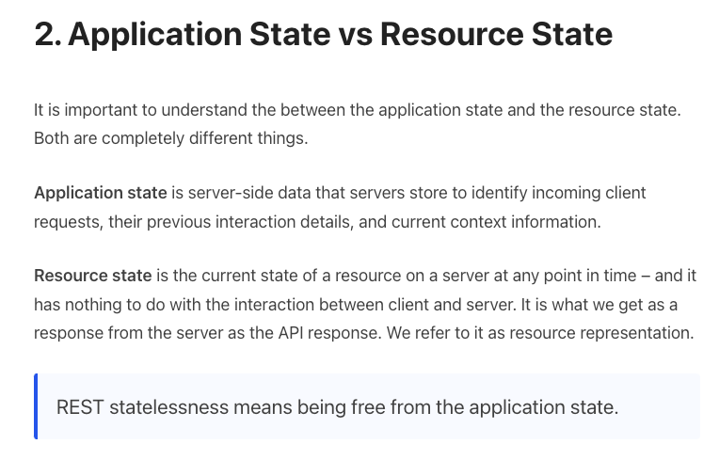
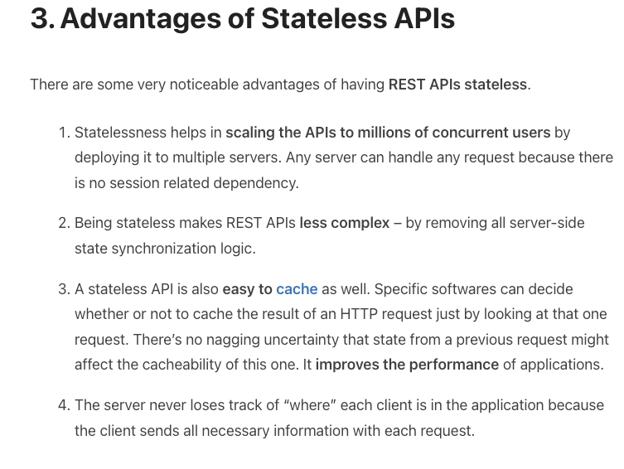
REST is Stateless (https://restfulapi.net/statelessness/)

Slide 11
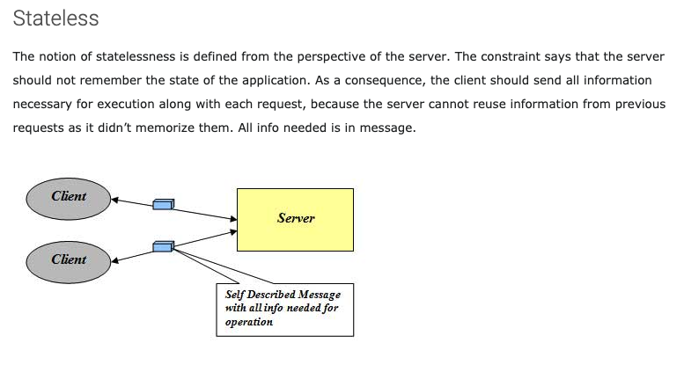
Stateless
http://mrbool.com/rest-architectural-elements-and-constraints/29339
Many platforms provided server-side functions to save session/conversation/application state.
Caching results of previous DB queries.
Current navigation position in a complex, multi-page application.
Transaction/Saga status
Logging context
etc.
REST keeps the information in various headers or cookies. The browser re-provides the information on each request.
This is another use for JWT.

Slide 12
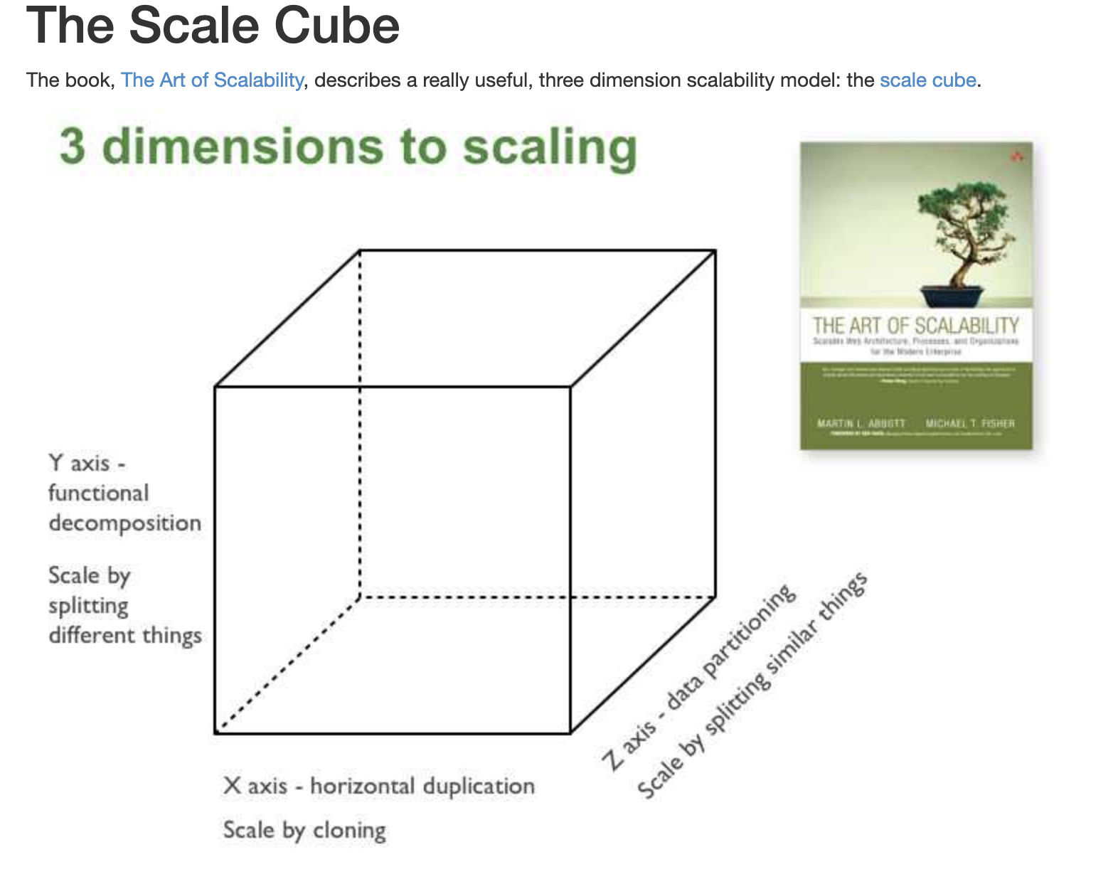
Microservices Scalability Cube
https://microservices.io/articles/scalecube.html
X-axis scaling consists of running multiple copies of an application behind a load balancer. If there are N copies then each copy handles 1/N of the load. This is a simple, commonly used approach of scaling an application.
Y-axis axis scaling splits the application into multiple, different services. Each service is responsible for one or more closely related functions.
When using Z-axis scaling each server runs an identical copy of the code. In this respect, it’s similar to X-axis scaling. The big difference is that each server is responsible for only a subset of the data. Some component of the system is responsible for routing each request to the appropriate server

Slide 13
XYZ – Scaling
There are three dimensions.
A complete solution/environment typical is a mix and composition of patterns.
Application design and data access determines opitions.

Slide 14
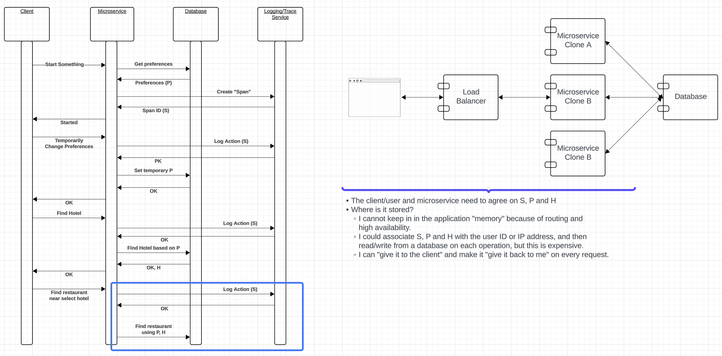
Conversation/Session State
If I have lots and lots of active clients, the easiest way to scale is to keep the state in the “client.”

Slide 15
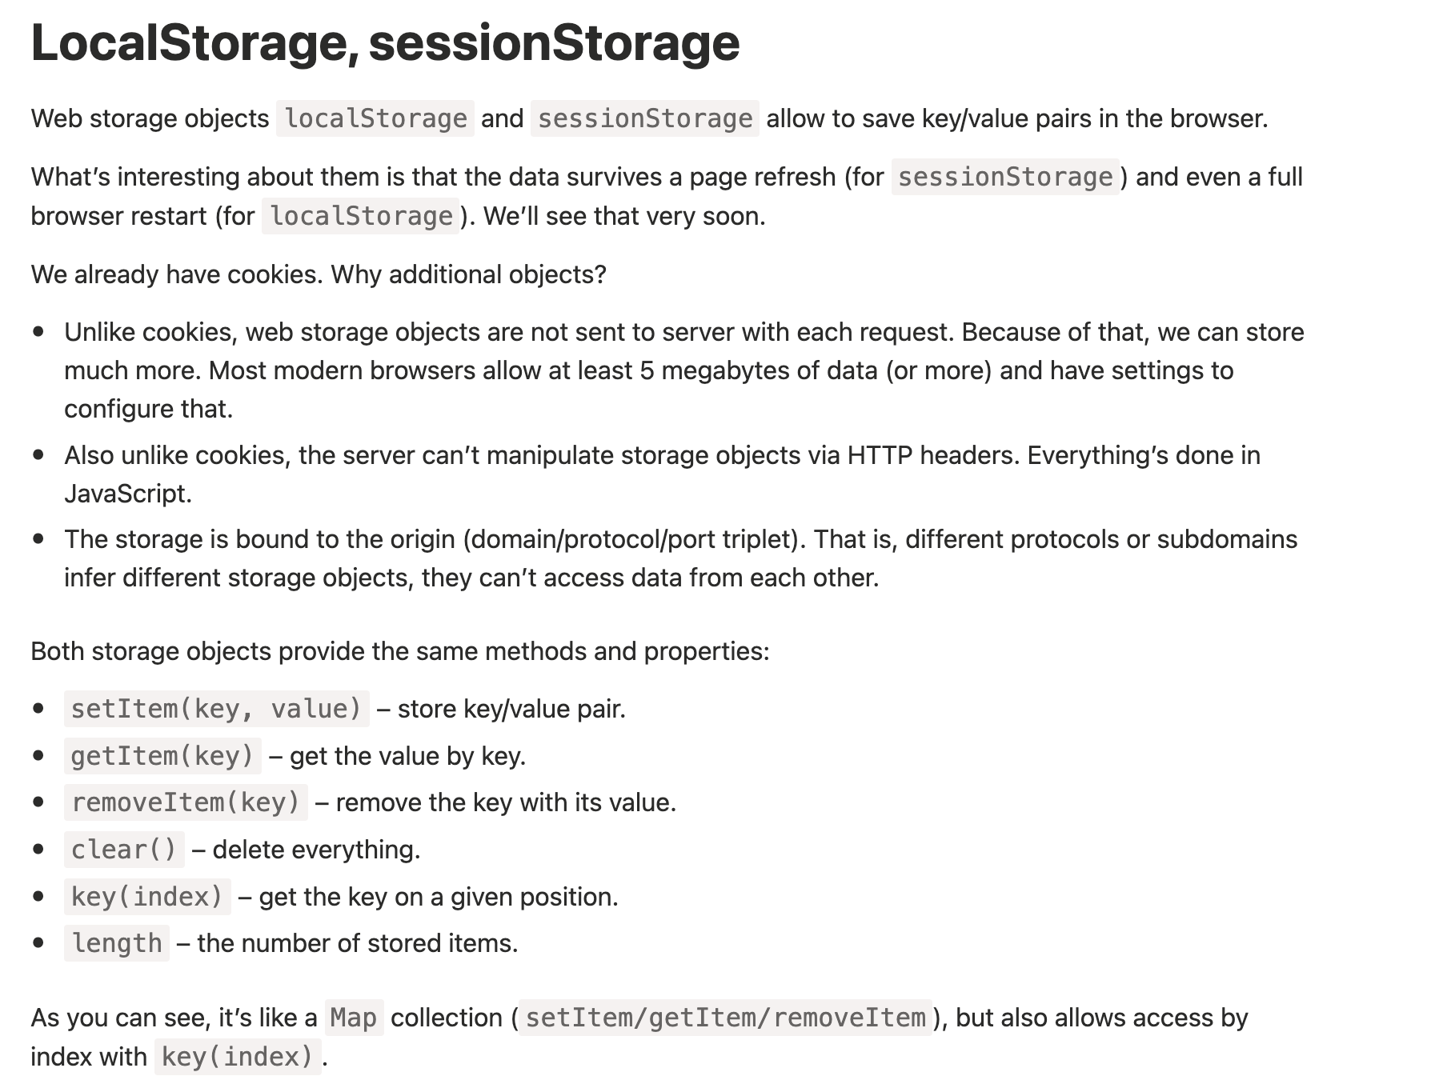
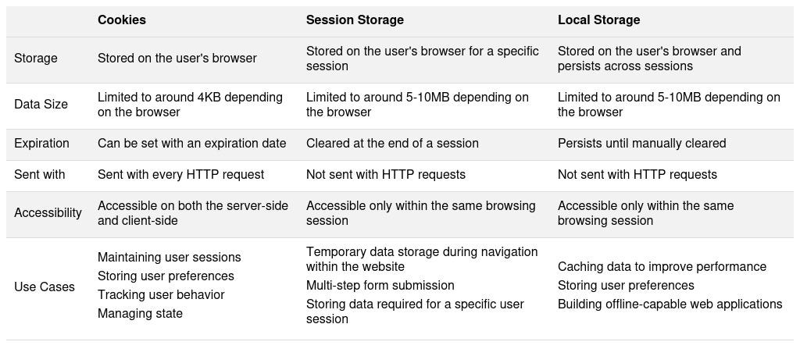
Browser Storage
Not automatically sent with all HTTP requests, but … …
The client application TypeScript can add to requests, and update based on responses.
The server can specify in the API definition that there is a “token” that is sent to the API and then back to the client.
The token can be “opaque” and “signed” for integrity by the server.
This is the same mechanism/process for the Access Token.

Slide 16
Idempotent
Introduction
16 | W4153-F24-8-REST-PaaS-FaaS-Logic-Placement-Composition-EDA-MDP © Donald F. Ferguson, 2024

Slide 17
Idempotent
From Wikpedia (https://en.wikipedia.org/wiki/Idempotence)
“Idempotence is the property of certain operations in mathematics and computer science whereby they can be applied multiple times without changing the result beyond the initial application.”
“In the Hypertext Transfer Protocol (HTTP), idempotence and safety are the major attributes that separate HTTP methods. Of the major HTTP methods, GET, PUT, and DELETE should be implemented in an idempotent manner according to the standard, but POST doesn't need to be. GET retrieves the state of a resource; PUT updates the state of a resource; and DELETE deletes a resource. As in the example above, reading data usually has no side effects, so it is idempotent (in fact nullipotent). Updating and deleting a given data are each usually idempotent as long as the request uniquely identifies the resource and only that resource again in the future.”
Why does this matter? Ultimately, if I do a PUT and do not get an answer, my code has no way of distinguishing between:
The request got “lost” and was not processed.
The request was processed and the response got lost.
But more fundamentally, the network is flaky and loses messages, loses responses, retransmit messages, … …

Slide 18
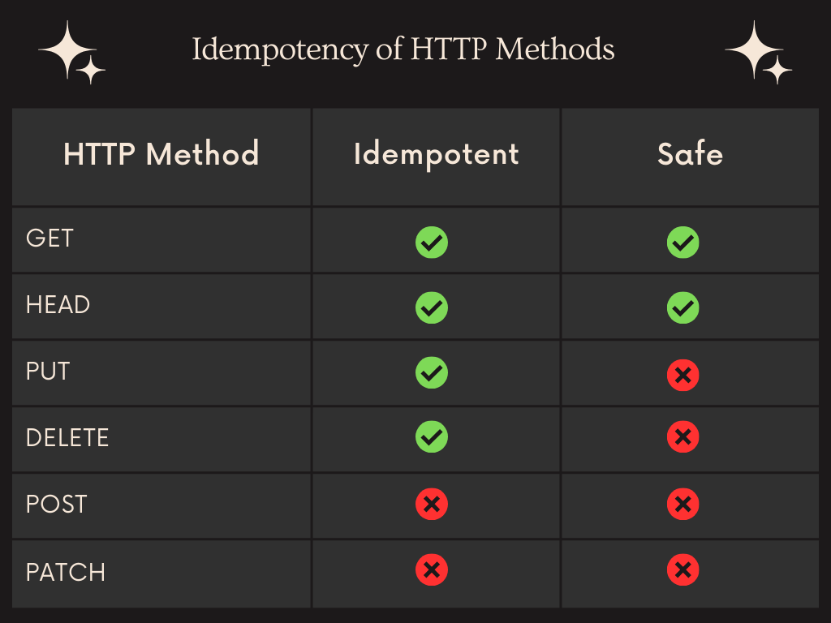
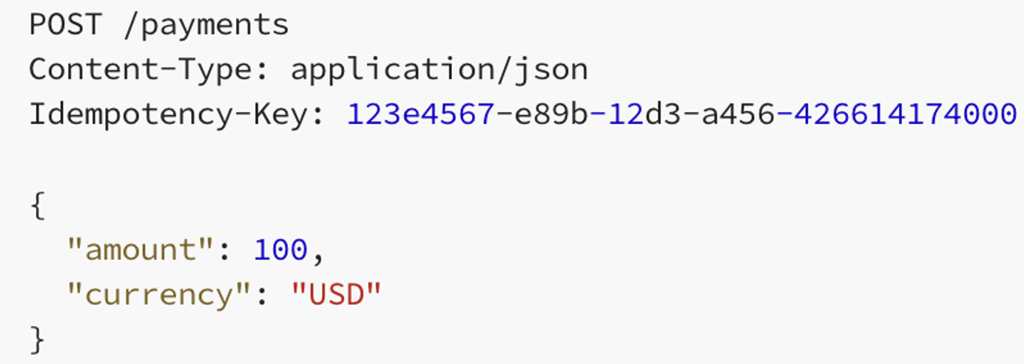
Idempotent
https://restfulapi.net/idempotent-rest-apis/
There are several techniques for ensuring correct implementation of idempotent processing.
Examples:
Nonce (Idempotent Key)
Condition processing based on resources current state.
Idempotent Key
Client generates the UUID.
If the server has not processed the key, process and “remember” the response.
If the server has processed the key, return the previous answer.

Slide 19
Platform-as-a-Service Function-as-a-Service
19 | W4153-F24-8-REST-PaaS-FaaS-Logic-Placement-Composition-EDA-MDP © Donald F. Ferguson, 2024

Slide 20
Reminder Context
Introduction
20 | W4153-F24-8-REST-PaaS-FaaS-Logic-Placement-Composition-EDA-MDP © Donald F. Ferguson, 2024

Slide 21
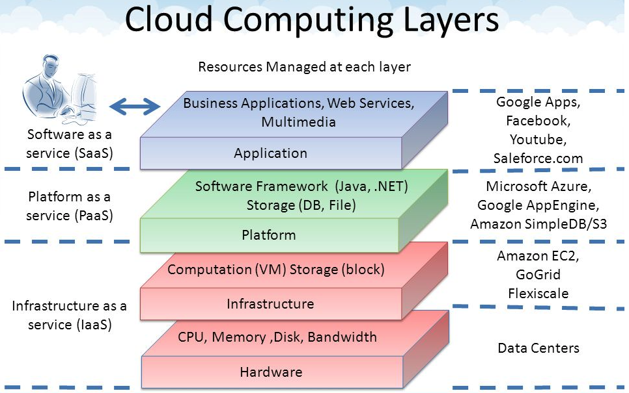
Core Layers
Our first cloud elements will
be IaaS (VMs).
Google Apps
Salesforce, Zendesk, ServiceNow, Concur, ... ...
Office 365, Trello
... ...
Google App Engine, AWS Elastic Beanstalk, ...
AWS SQS, Azure Queuing Service, Google PubSub
DynamoDB, Cosmos DB, ... ...
... ...
AWS EC2, Google Compute Engine, Azure VMs, ... ...
AWS Elastic Container Service, Azure Kubernetes, ... ...
IaaS is compute, storage, networking.
With an OS.
Delivered as a set of VMs and/or containers.

Slide 22
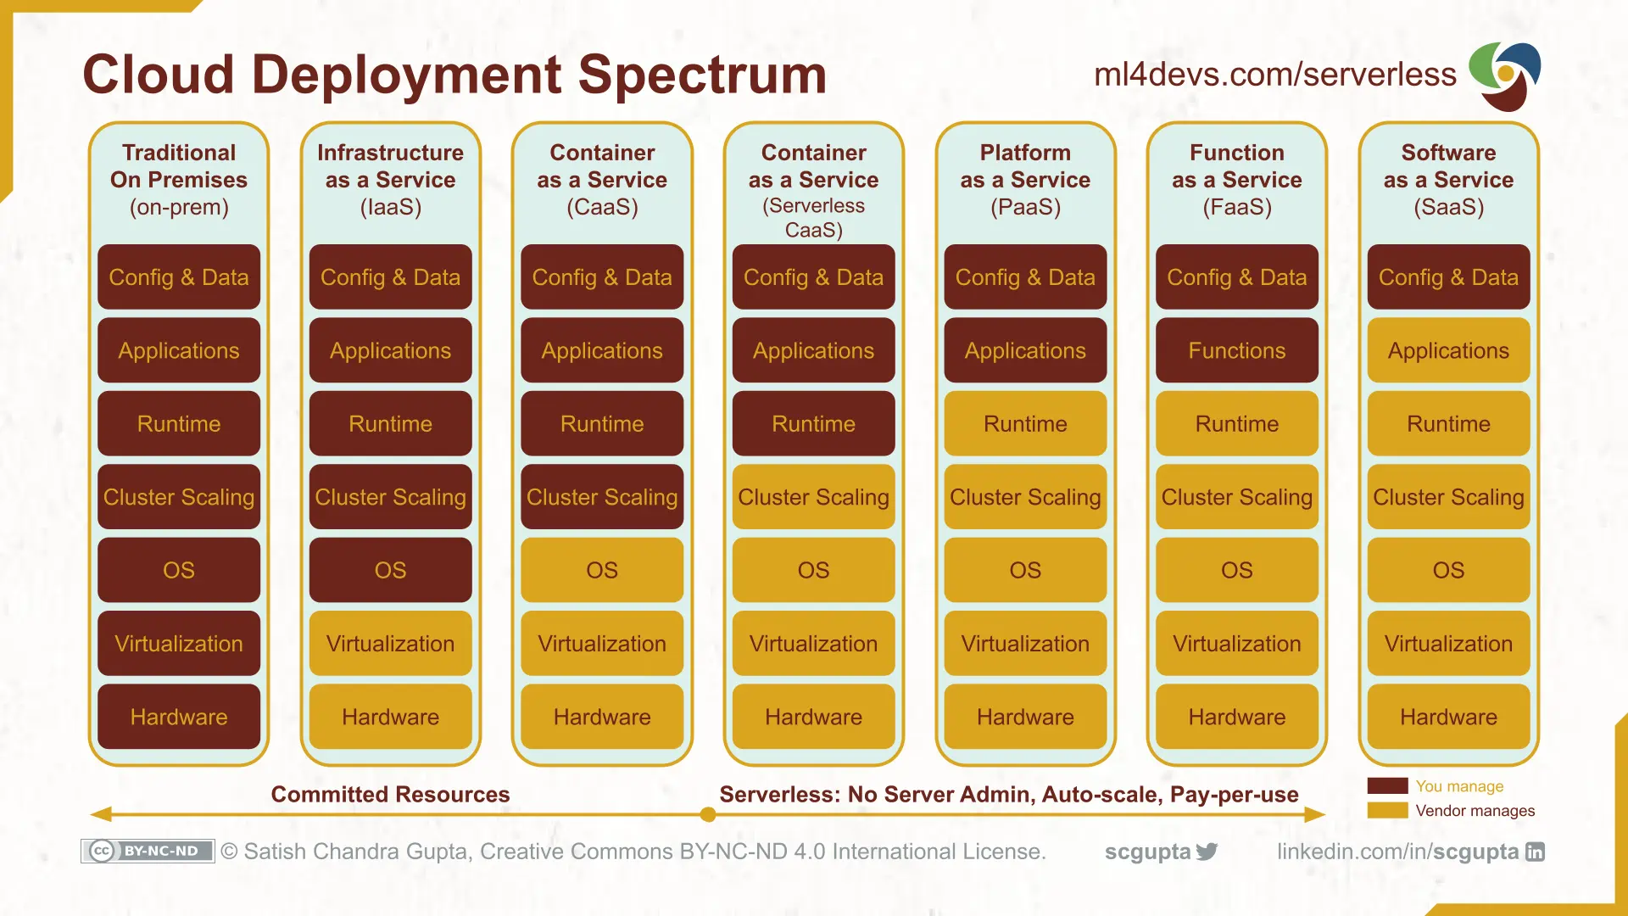
Cloud Layers

Slide 23
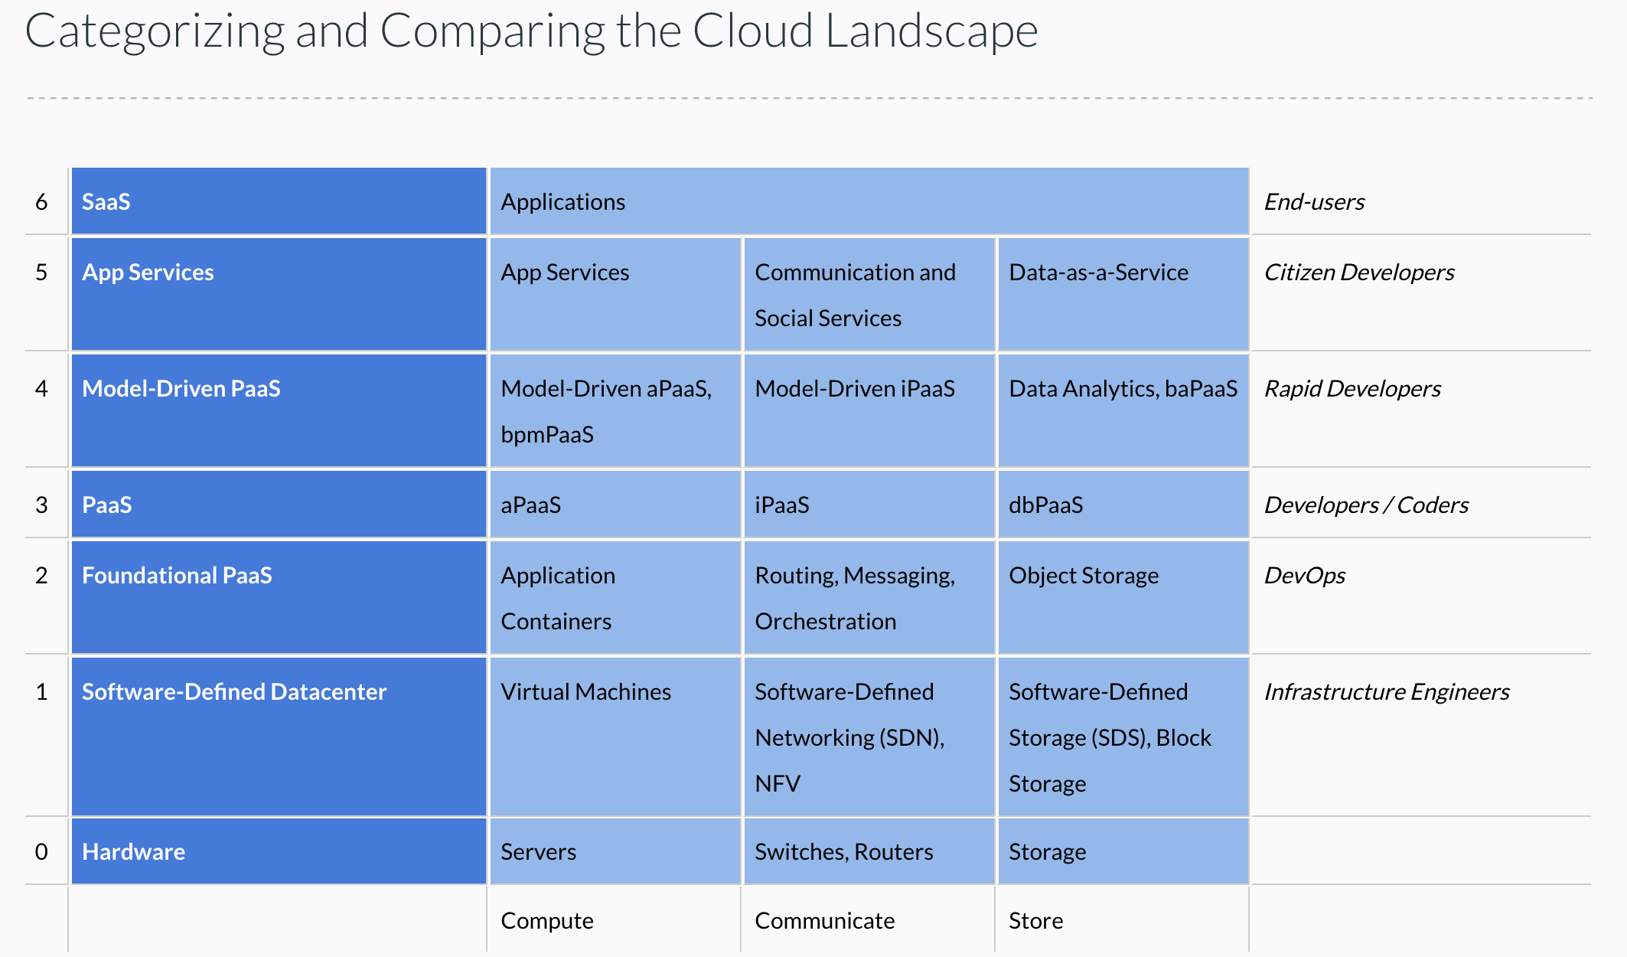
Cloud Concepts – One Perspective
http://www.theenterprisearchitect.eu/blog/2013/10/12/the-cloud-landscape-described-categorized-and-compared/

Slide 24

Computer Models
Hardware
At the very core, you write a function or method.
A set of functions or methods become a resource.
A resource runs in a web application and uses required software, e. g. packages, libraries.
A web application run in some kind of container, which provides isolation, ensures pre-reqs, etc.
Containers run in an operating system.
An operating systems runs on HW, which may be a virtual machine and virtual resources.
Virtual resources run on hypervisors, which
Run on hardware.
This is like a matryoshka doll. Ultimately, I decide:
Which level of nesting is the package I am willing to/want to produce and deploy.
I provide that as a package/bundle and provide a declaration/manifest of what I want created and managed automatically for me.
This is over simplified and the boundaries blur.
Hypervisor
Virtual Machine
Operating System
Container
Web Application
Resource
Function/Method

Slide 25
Platform-as-a-Service
Introduction
25 | W4153-F24-8-REST-PaaS-FaaS-Logic-Placement-Composition-EDA-MDP © Donald F. Ferguson, 2024

Slide 26
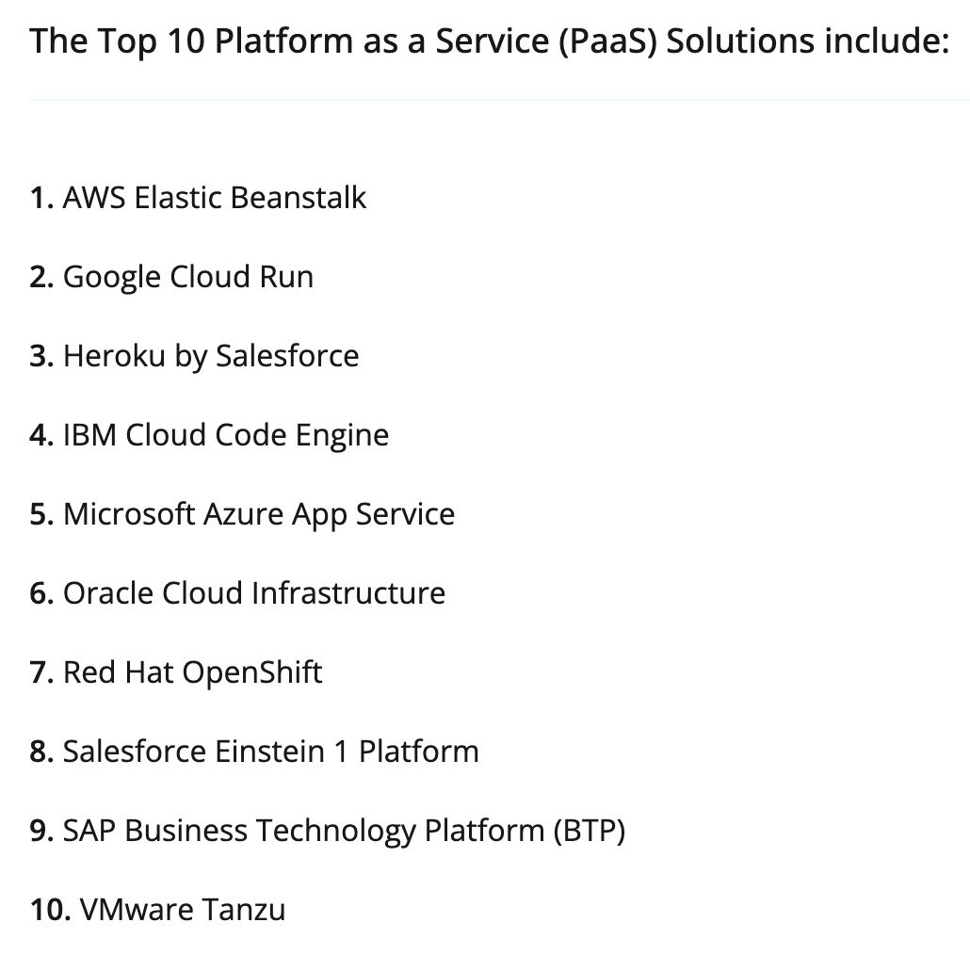
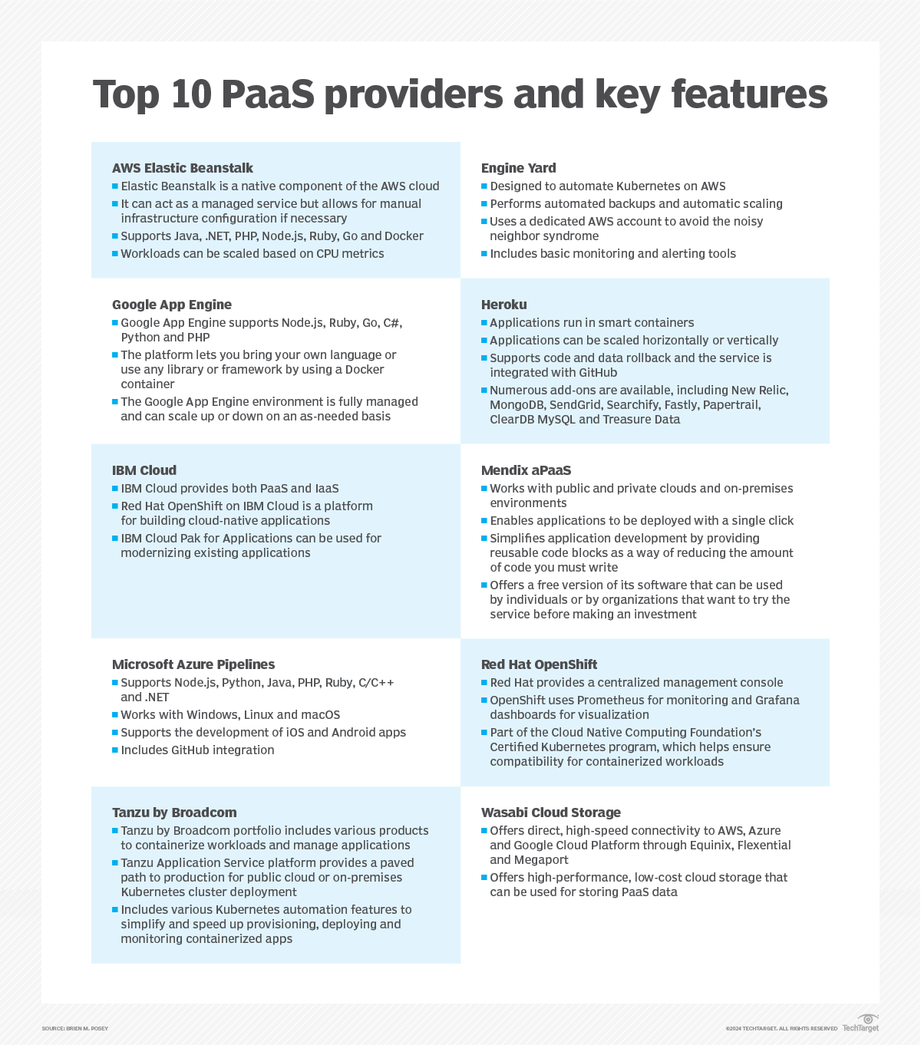
PaaS
https://expertinsights.com/insights/the-top-platform-as-a-service-paas-solutions/
The concept is common and widely used.
I have no idea if these lists are correct.
There are subtle differences in the terms.
https://www.techtarget.com/searchcloudcomputing/feature/Top-10-PaaS-providers-and-what-they-offer-you

Slide 27
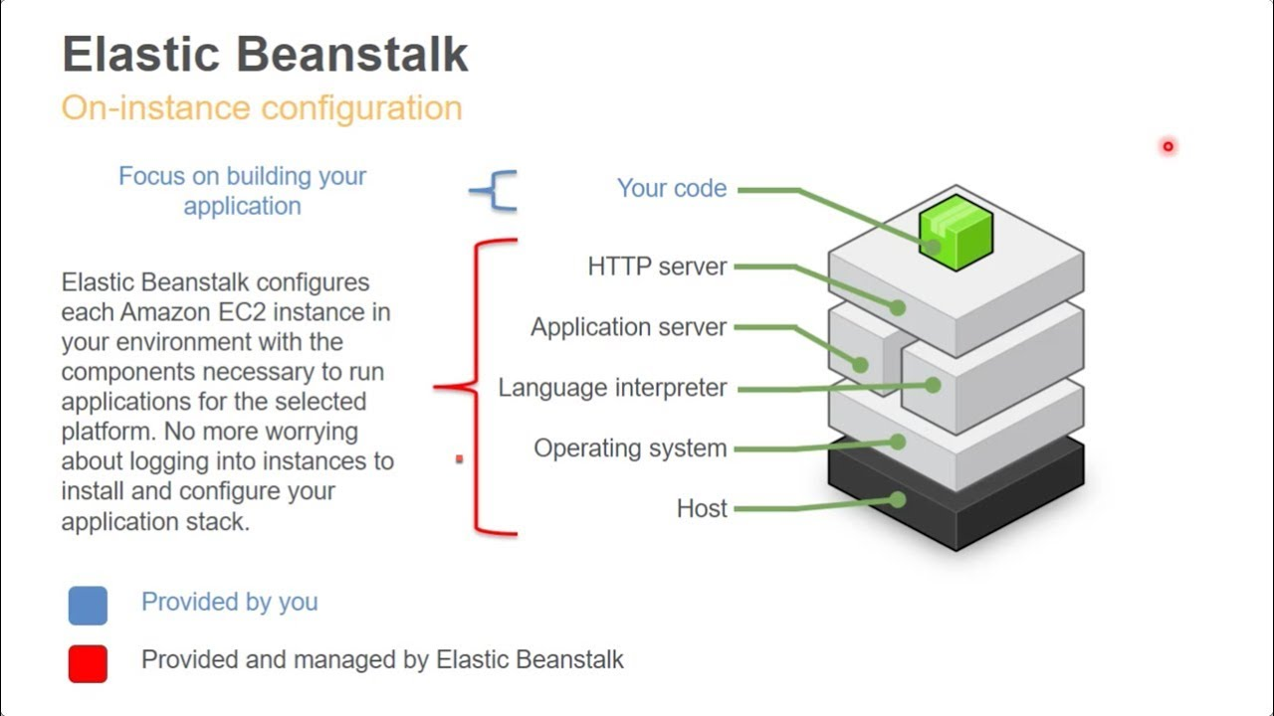
Elastic Beanstalk

Slide 28
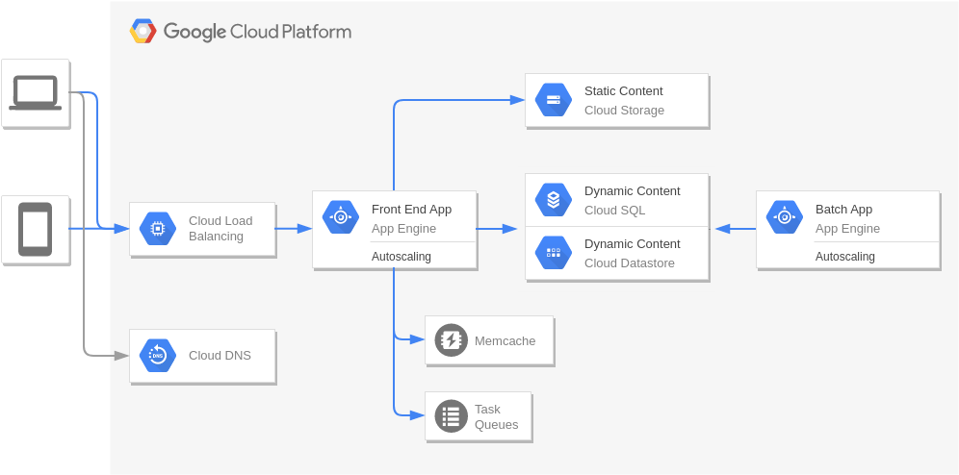
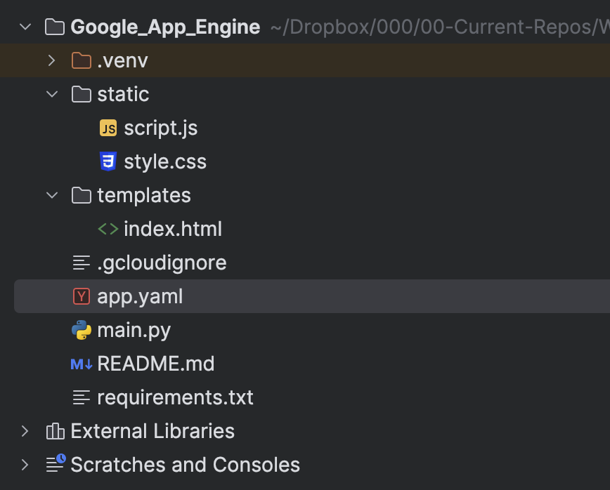
Google Cloud App Engine
Larger Application Architecture
In this simple example, the application is:
/static/script.js, /static/style.css
/templates/index.html
main.py
The directory/folder as a whole is the “deployment package” or the “inner doll.”
The declaration of what is needed from the encapsulating/containing dolls is in:
requirements
app.yaml
The deployment:
Zips the files into a package.
Uploads.
Triggers a build and deployment workflow.
You can do with with the gcloud cli.

Slide 29
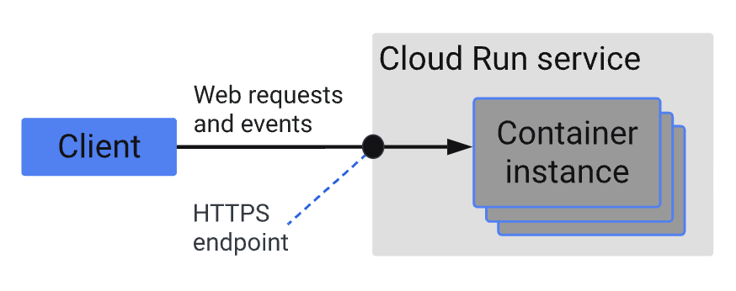
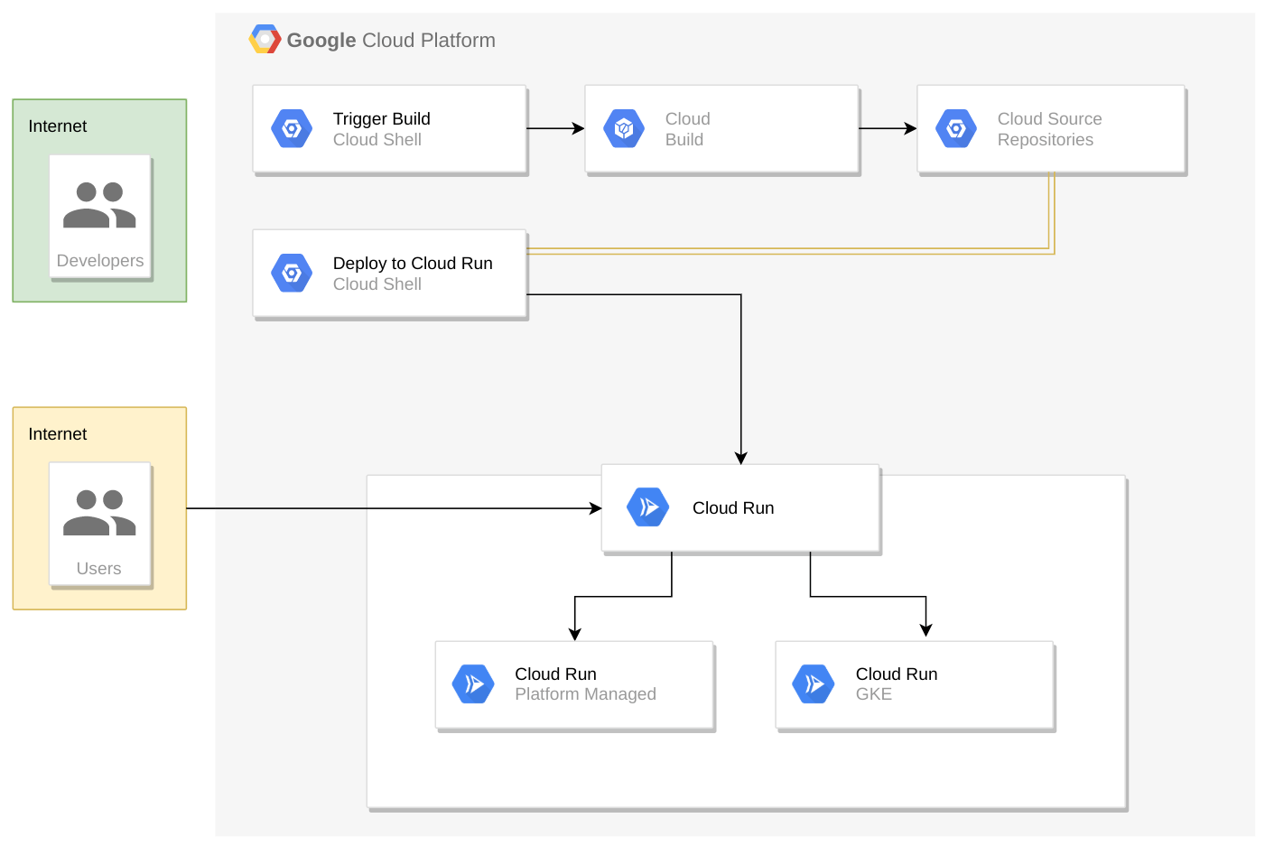
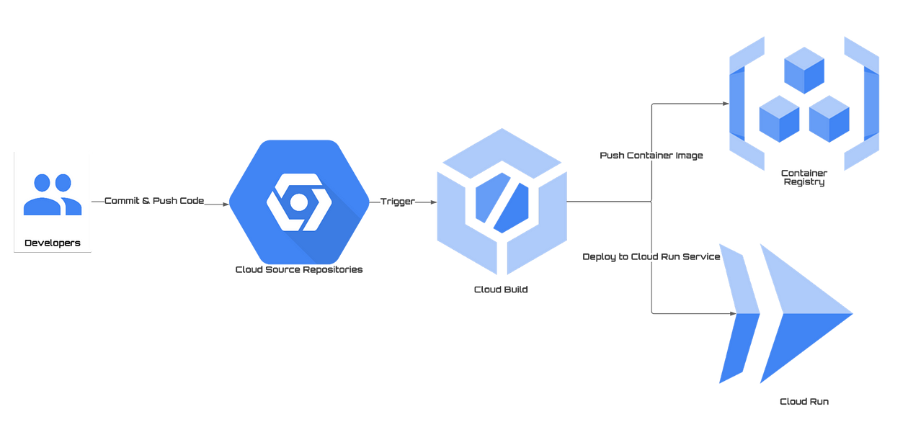
Cloud Run
Cloud Run (https://cloud.google.com/run/docs/overview/what-is-cloud-run?hl=en) is similar but uses containers and a container registry.
AWS Elastic Beanstalk added a similar model as containers became more common.

Slide 30
A Ton of Tutorials
Google App Engine
https://cloud.google.com/appengine/docs/standard/python3/building-app
https://itnext.io/deploy-your-fastapi-app-in-serverless-google-app-engine-f85580bd4157
https://medium.com/analytics-vidhya/deploying-fastapi-application-in-google-app-engine-in-standard-environment-dc061d3277a
https://tutlinks.com/deploy-fastapi-app-on-google-cloud-platform/
Google Cloud Run
https://cloud.google.com/run/docs/quickstarts/build-and-deploy/deploy-python-service?hl=en
https://codelabs.developers.google.com/cloud-run-starter-app#0
Elastic Beanstalk
https://docs.aws.amazon.com/elasticbeanstalk/latest/dg/GettingStarted.html
https://docs.aws.amazon.com/elasticbeanstalk/latest/dg/tutorials.html

Slide 31
Function-as-a-Service (Next Lecture)
Introduction
31 | W4153-F24-8-REST-PaaS-FaaS-Logic-Placement-Composition-EDA-MDP © Donald F. Ferguson, 2024

Slide 32
Serverless and Function-as-a-Service
Serverless computing is a cloud computing execution model in which the cloud provider runs the server, and dynamically manages the allocation of machine resources. Pricing is based on the actual amount of resources consumed by an application, rather than on pre-purchased units of capacity.^{[1]} It can be a form of utility computing. Serverless computing can simplify the process of deploying code into production. Scaling, capacity planning and maintenance operations may be hidden from the developer or operator. Serverless code can be used in conjunction with code deployed in traditional styles, such as microservices. Alternatively, applications can be written to be purely serverless and use no provisioned servers at all.^{[2]} This should not be confused with computing or networking models that do not require an actual server to function, such as peer-to-peer (P2P).”
Function as a service (FaaS) is a category of cloud computing services that provides a platform allowing customers to develop, run, and manage application functionalities without the complexity of building and maintaining the infrastructure typically associated with developing and launching an app.^{[1]} Building an application following this model is one way of achieving a "serverless" architecture, and is typically used when building microservices applications.”
That was baffling:
IaaS, CaaS – You control the SW stack and the cloud provides (virtual) HW.
PaaS – The cloud hides the lower layer SW and provides an application container (e.g. Flask) with “Your code goes here.” You are aware of container.
FaaS – The cloud provides the container, and you implement functions (corresponding to routes in REST).

Slide 33
Serverless and Function-as-a-Service
https://medium.com/@tanmayct/serverless-architecture-function-as-a-service-19e127b8c990

Slide 34









What is Serverless Good/Not Good For ... ...
Serverless is good for
short-running
stateless
event-driven
Serverless is not good for
long-running
stateful
number crunching
Microservices
Databases
Mobile Backends
Deep Learning Training
Bots, ML Inferencing
Heavy-Duty Stream Analytics
IoT
f(x)
Numerical Simulation
Modest Stream Processing
Video Streaming
Service integration

Slide 35

What triggers code execution?
Runs code in response to events
Event-programming model
Notes:
What is Serverless

Slide 36



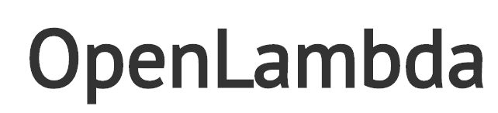







(Some) Current Platforms for Serverless
AWS Lambda
Azure Functions
Kubernetes
IBM Cloud Functions
Red-Hat
Google Functions
Notes:
Auth0, Twitter, ..
And many more upcoming / open source

Slide 37
Summary of Models for Deploying your Application
Introduction
37 | W4153-F24-8-REST-PaaS-FaaS-Logic-Placement-Composition-EDA-MDP © Donald F. Ferguson, 2024

Slide 38
Summary (TBD)

Slide 39
Application Development Concepts
39 | W4153-F24-8-REST-PaaS-FaaS-Logic-Placement-Composition-EDA-MDP © Donald F. Ferguson, 2024

Slide 40
My Framework or Style
Introduction
40 | W4153-F24-8-REST-PaaS-FaaS-Logic-Placement-Composition-EDA-MDP © Donald F. Ferguson, 2024

Slide 41
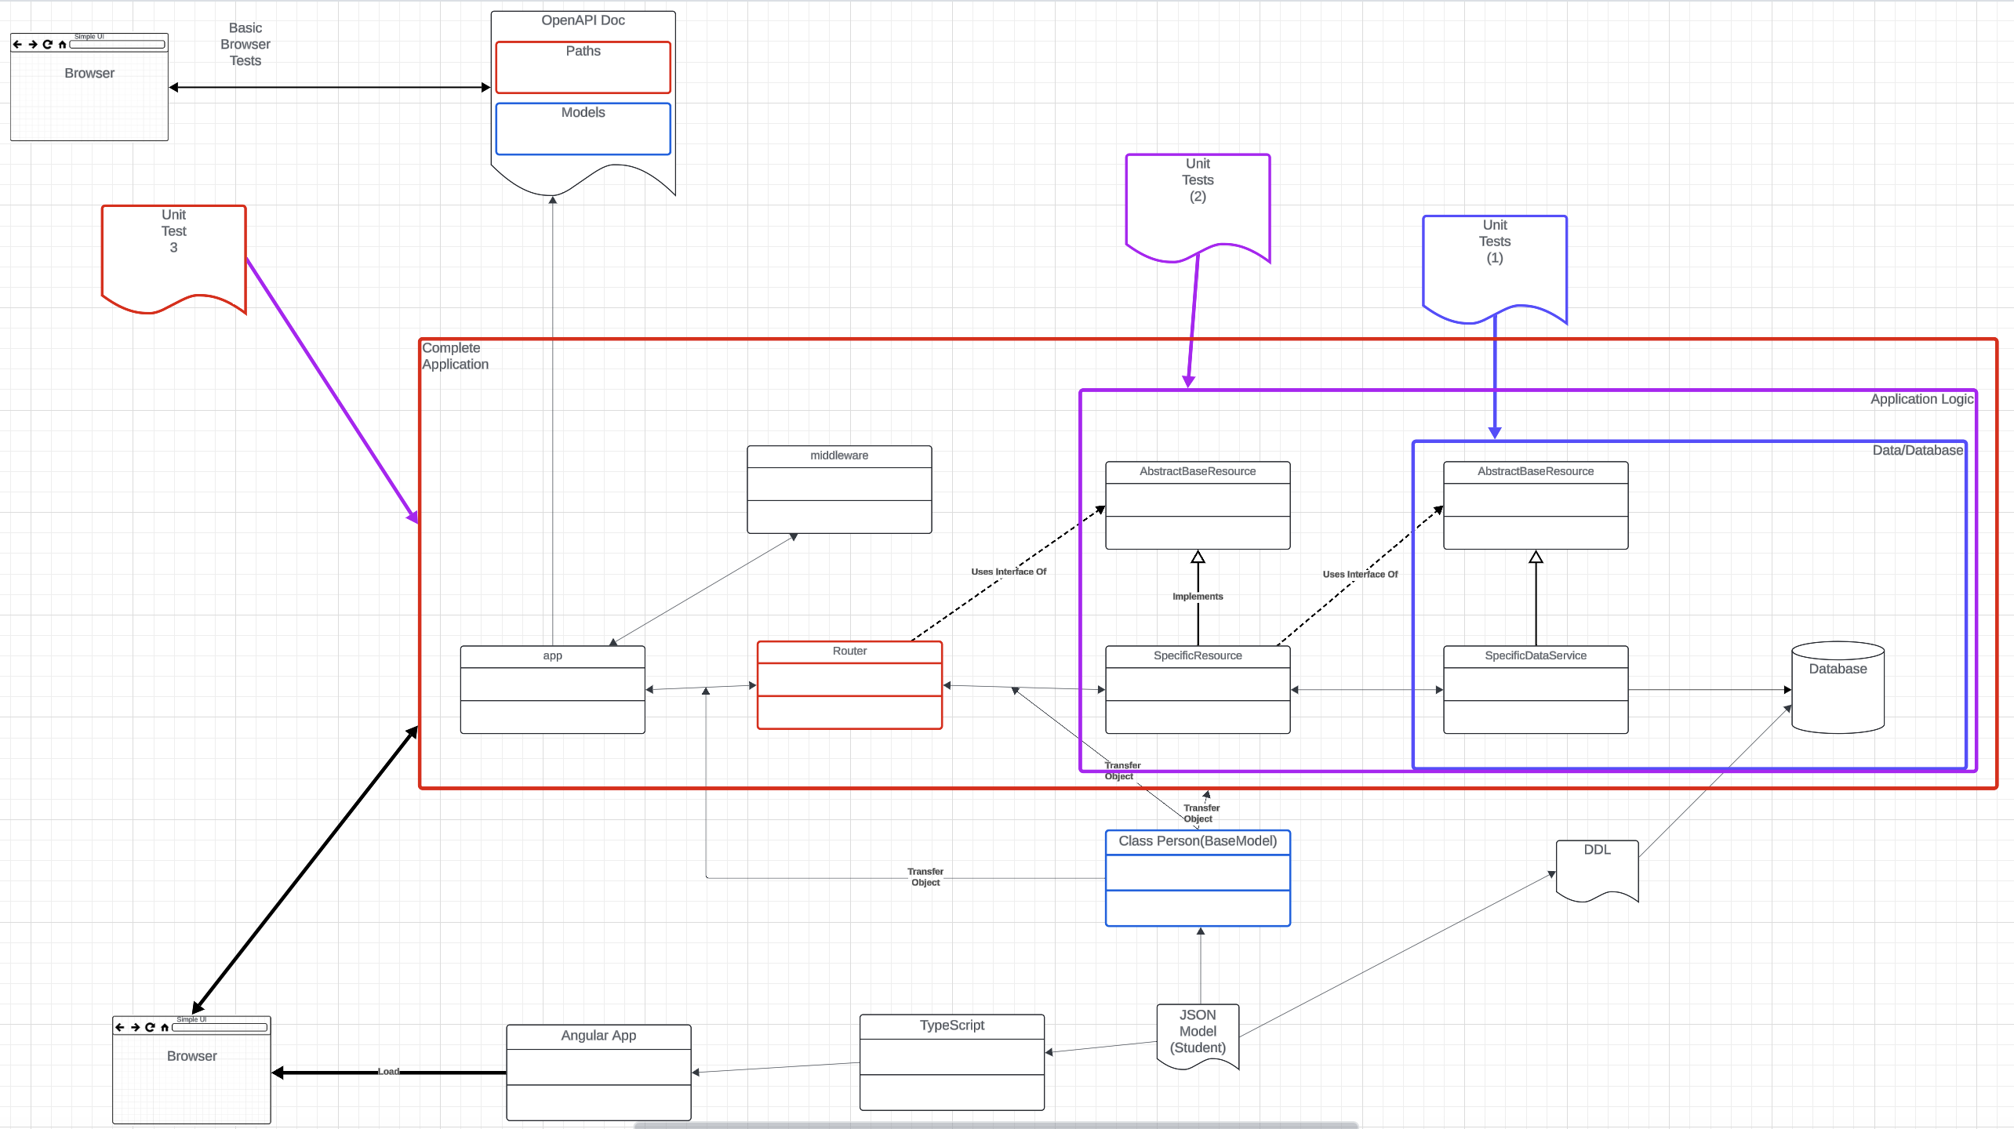
My Framework/Style
Three elements:
Data layer
Application layer
Full application
I can unit test in that order with standalone tests.
If the previous tests worked …
The error is in the new code.
Models are core to the design:
Defines resource definitions
Define “forms”
I build and test:
The UI separately
Can use “mock up” server to decouple.

Slide 42
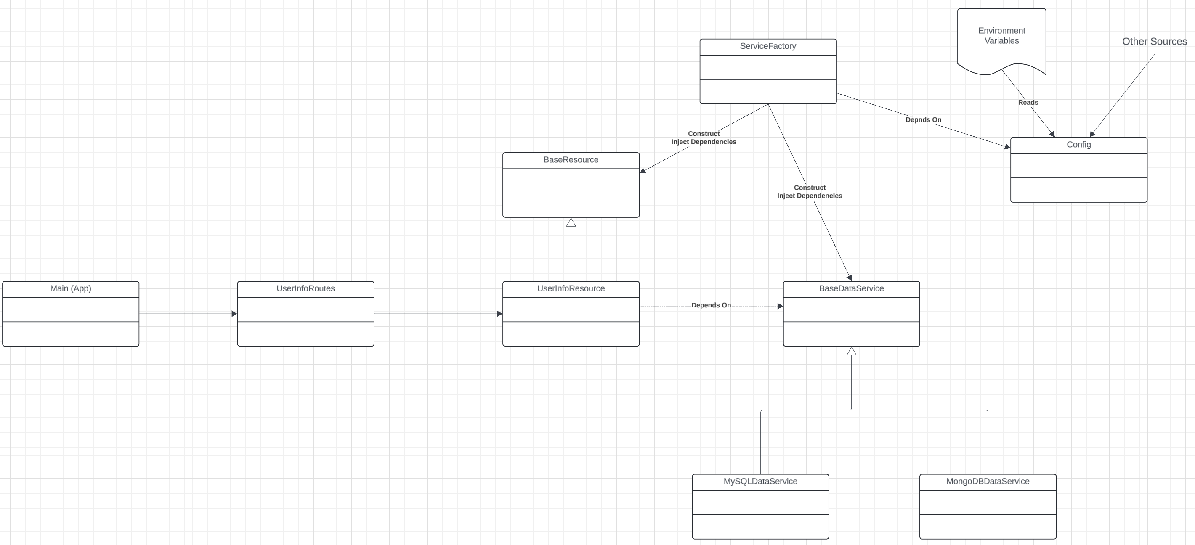
Framework

Slide 43
Sprint 2 – Discussion
43 | W4153-F24-8-REST-PaaS-FaaS-Logic-Placement-Composition-EDA-MDP © Donald F. Ferguson, 2024

Slide 44
Sprint 2 – Objectives
For all microservices: (As a team – define and implement a project template for all Microservices)
OpenAPI documentation.
Good response codes and error codes.
Links for HATEOS
At least one microservice implementing a complete REST interface and accessing a database. Complete means:
All methods and on all paths work/Have basic functionality for CRUD working.
/api/courses: GET, POST
/api/courses/{call_no}: GET, PUT, DELETE
On collection resources, e.g. /api/courses
Query string with parameters.
Pagination.
201 Created with a link header for a POST. Implement GET on link header for created resource.
Simple web UI that calls some of the services.

Slide 45
Sprint 2 – Objectives
One composite microservice/resource, e.g. /api/student_infos, /api/student_infos/{uni}:
Calls/delegates to atomic services for GET and POST.
202 Accepted and implementing an asynchronous update to a URL.
Implement one method synchronously and one asynchronously using threads, co-routines, …
Basic support for navigation paths, including query parameters, e.g. /student_infos/{uni}/courses, /student_infos/{uni}/teams
Middleware on each resource that implements before and after logging for all methods/paths.
Getting the URLs/dependencies from the environment variables.
Deploy the composite and components and test.
OAuth2, OpenIDC using Google login for composite service.
Overall project structure in GitHub:
Linked repositories.
First pass at a Trello board with a backlog.

